Slide 1
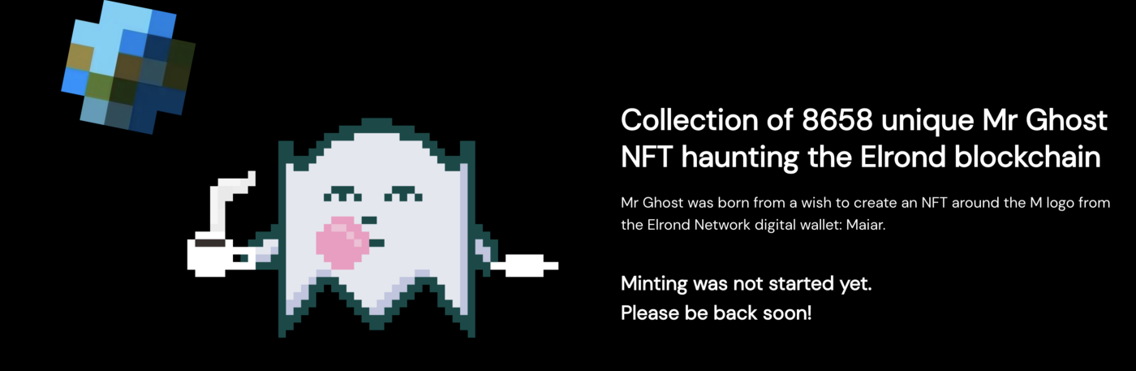
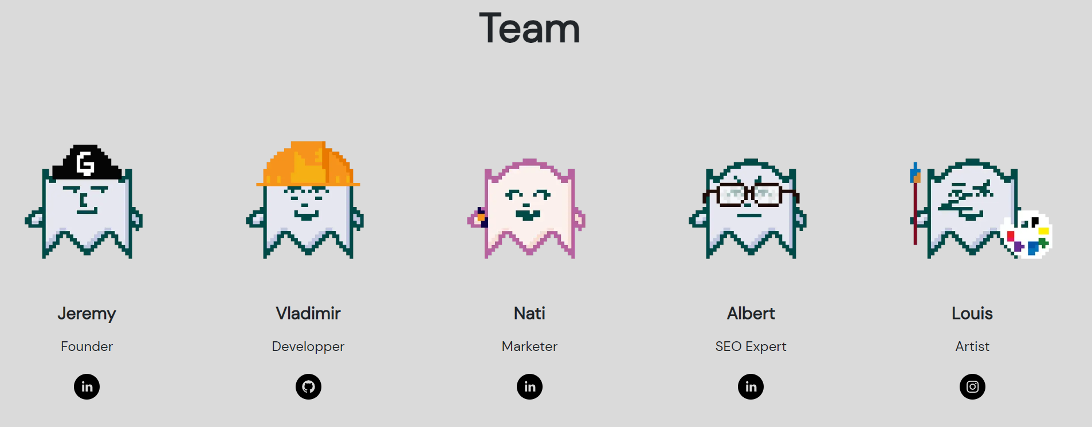
MetaMex NFT marketplace platform development on the Elrond blockchain
Vladimir Andrianov
Business Information Technology

Slide 2
Content
Introduction
Web 3.0, NFT
Elrond community platform, marketplace
Background
NFT market, competition
MetaMex marketplace
Frontend, Backend
Smart contracts, Infrastructure
DAO
Results
2

Slide 3
Introduction
3

Slide 4
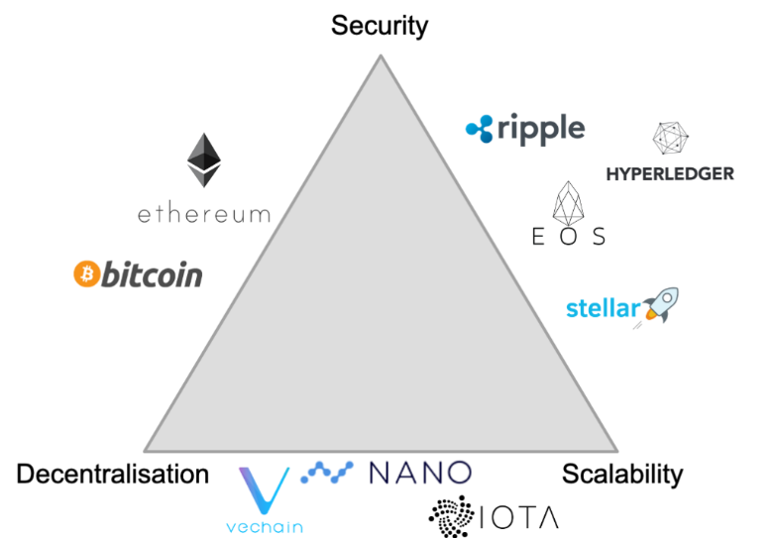
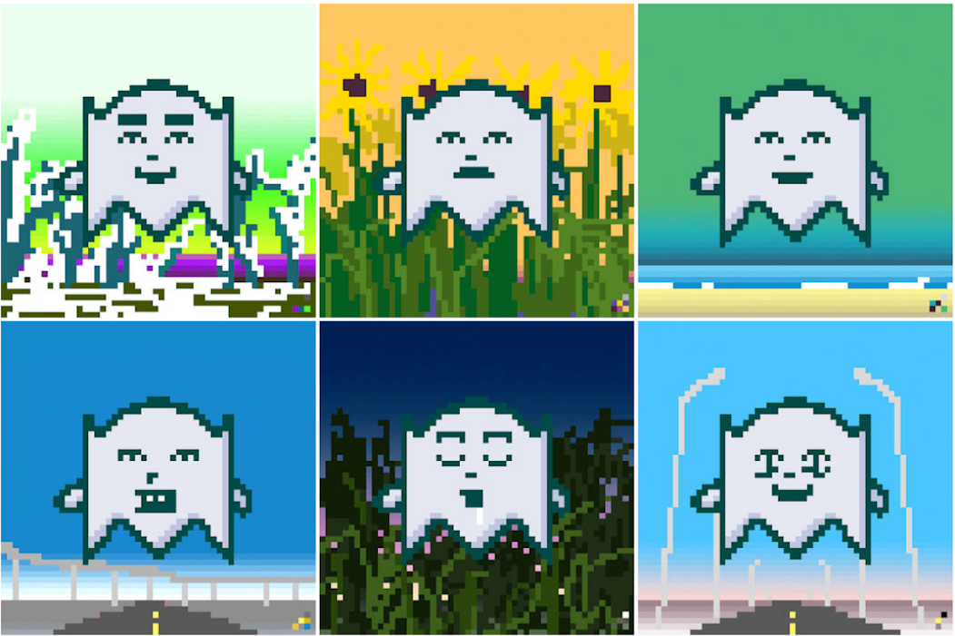
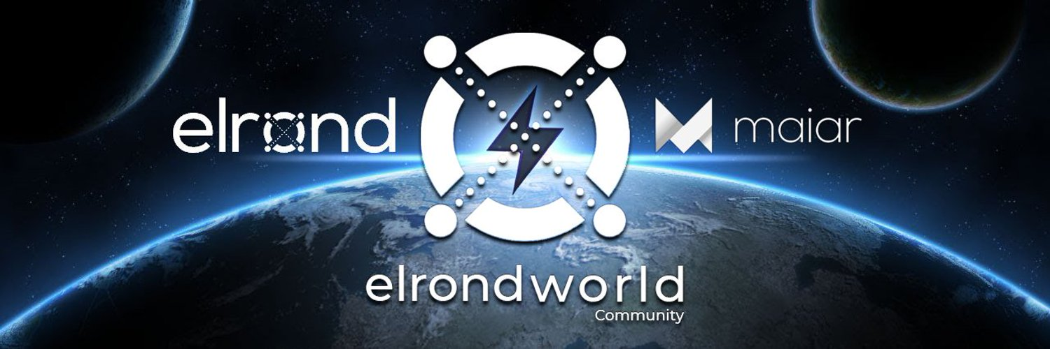
Introduction
Web 3.0
Transparency
Blockchain
Elrond
Third generation
NFT, smart contracts
Community platform
Gokai Labs
Elrond World
Blockchain trilemma
Gokai Labs’ Mr. Ghost collection
Elrond World community
4

Slide 5
Background
5

Slide 6
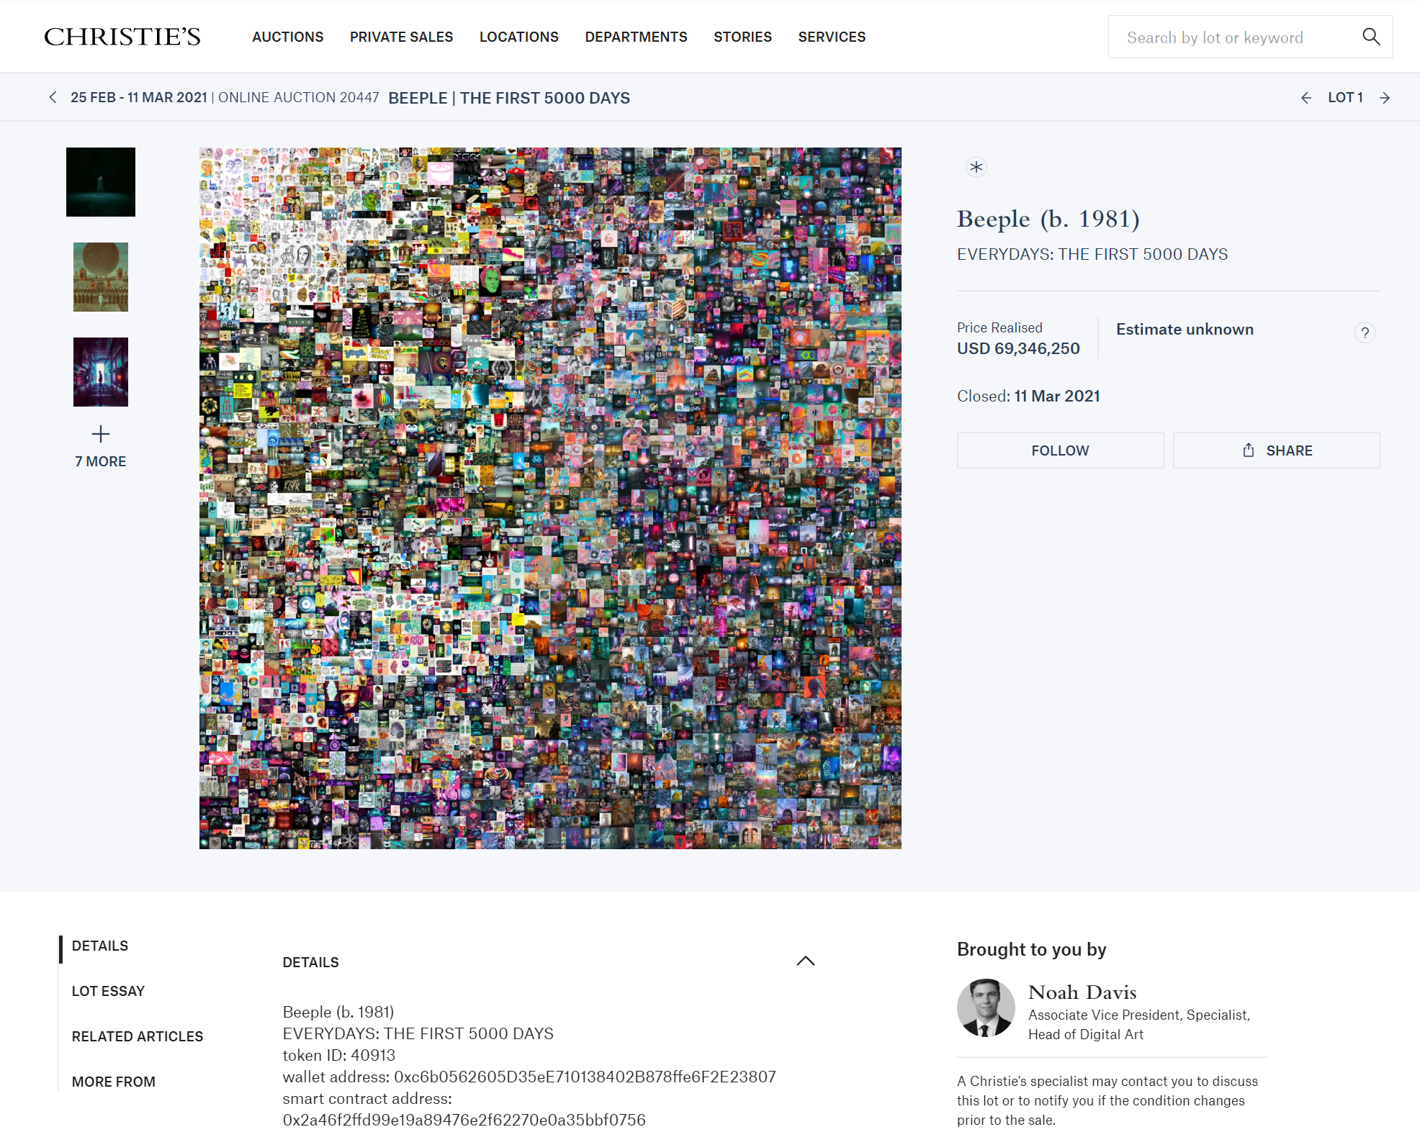
Background
NFT market
Ethereum
Elrond
Competition
Ethereum
OpenSea
Solana
Magic Eden
Elrond
eMoon
THE FIRST 5000 DAYS
6

Slide 7
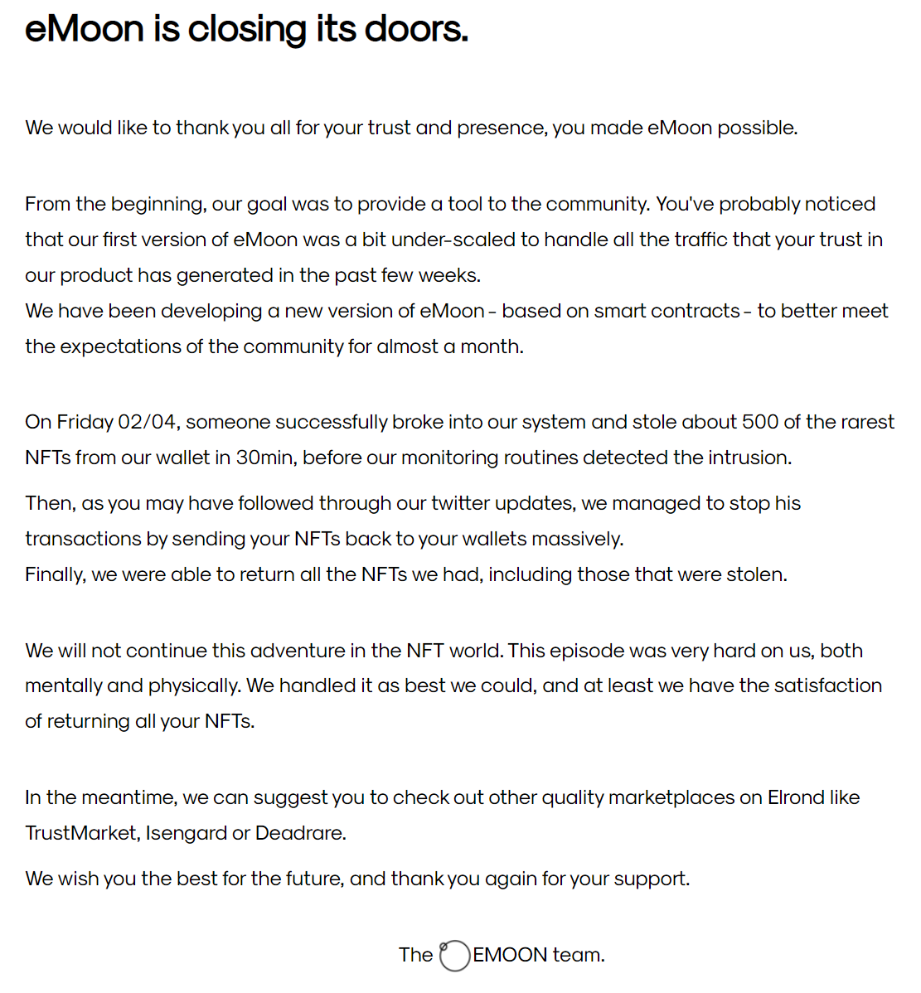
emoon
Gained popularity
Compromised
Closed
Wallet-based
NFT theft
Smart Contract v2
eMoon is closing its doors
7

Slide 8
MetaMex marketplace
8

Slide 9
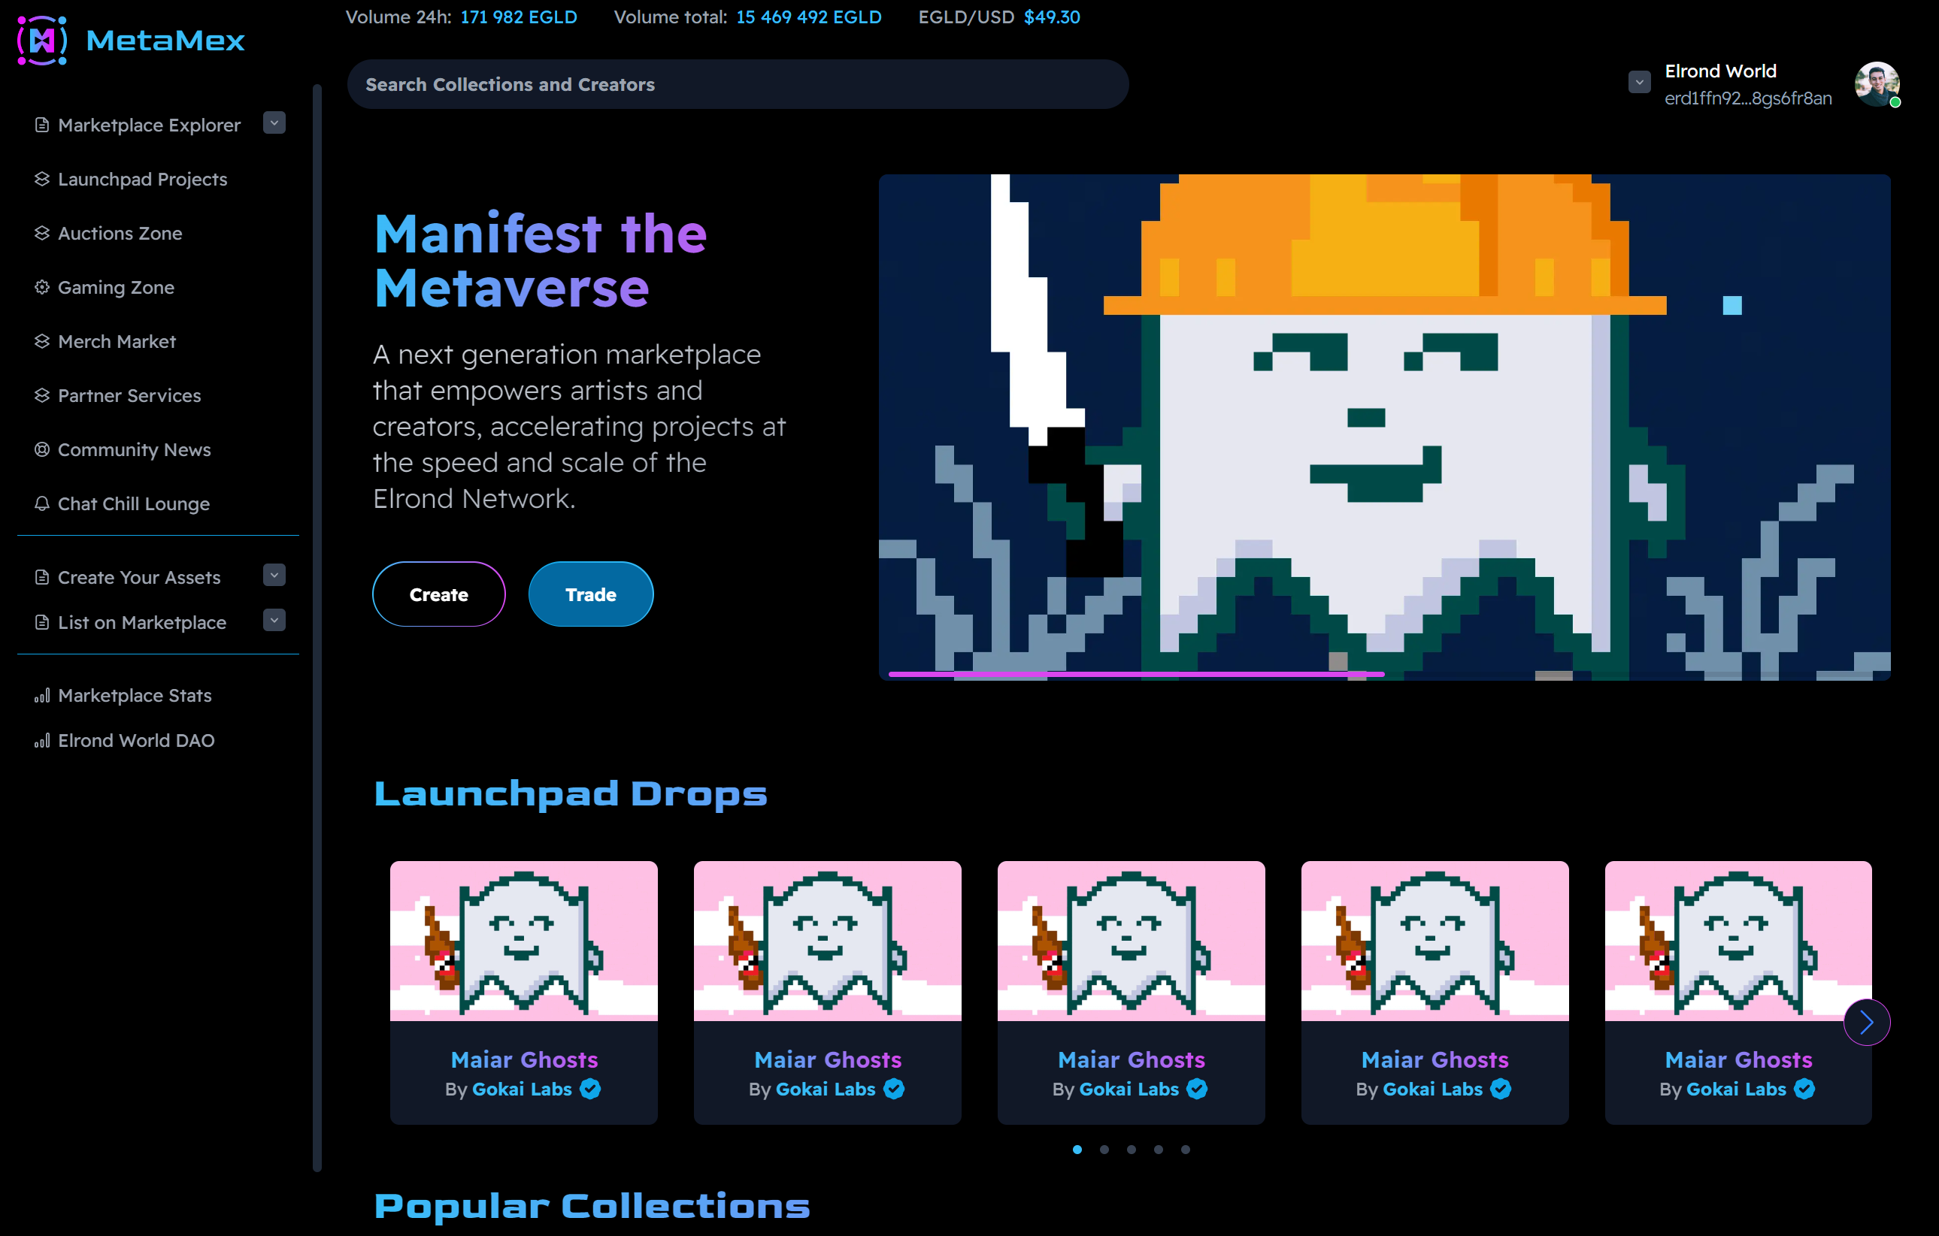
Frontend
Next.js
Wallet
Blog
Assets
Launchpad
Drops
MetaMex main page
9

Slide 10
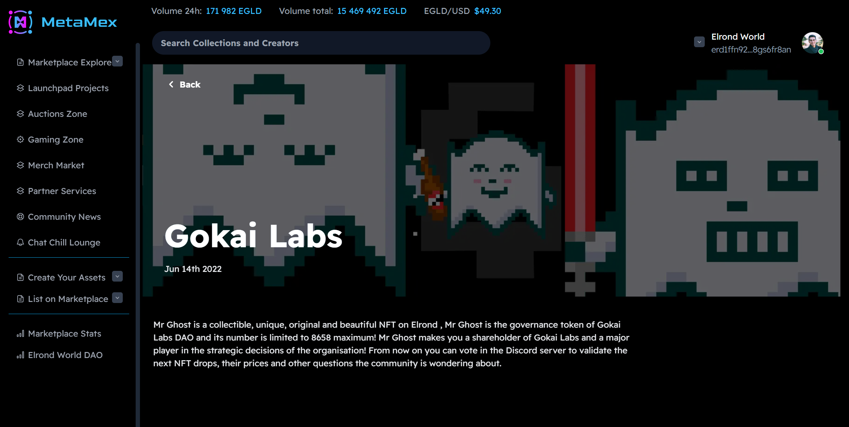
Blog
Strapi
CMS
Cloud
DB
MetaMex Gokai Labs blog
10

Slide 11
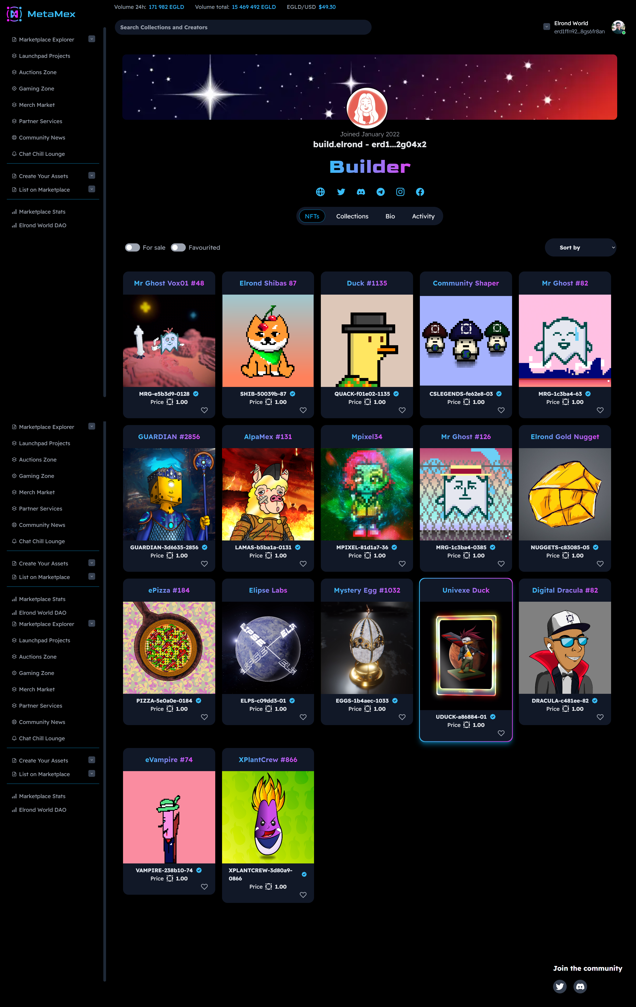
Profile
Personal space
Wallet
NFT Media
Collections

Slide 12
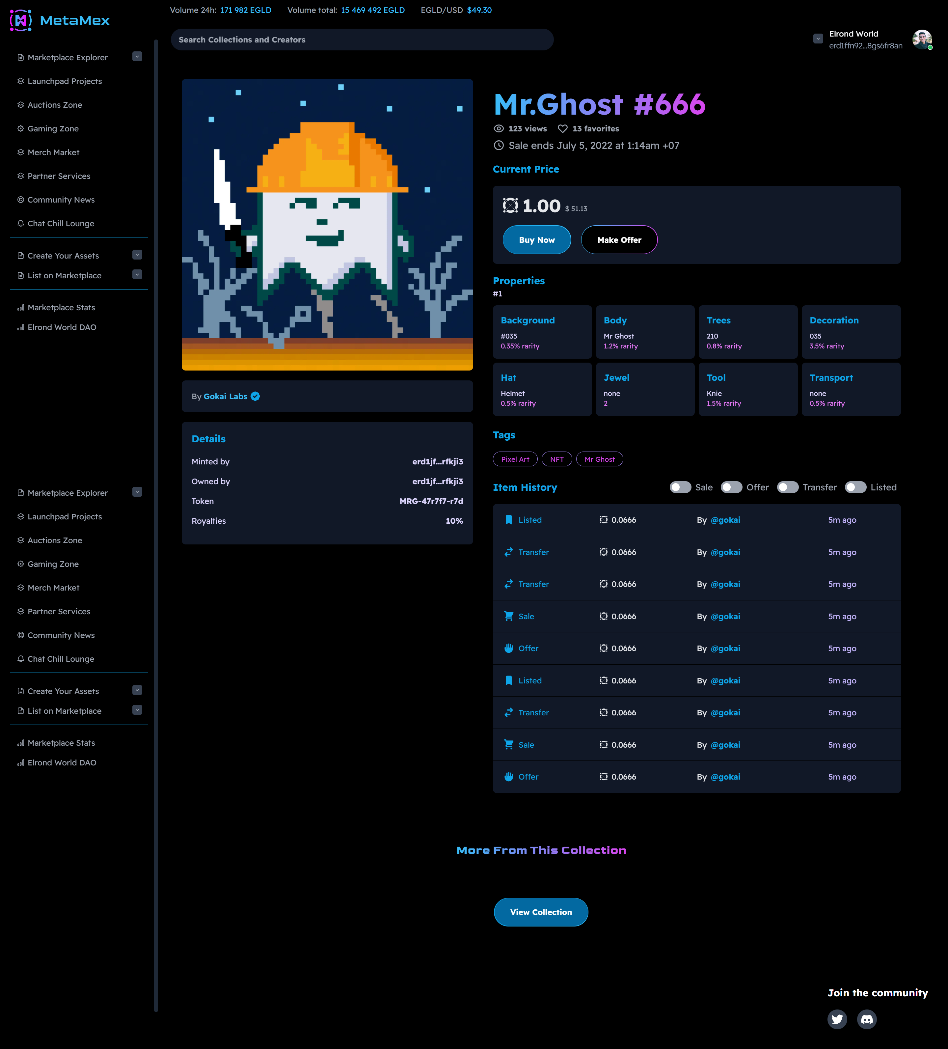
Nft page
Media
Properties
History
Offers
Royalties

Slide 13
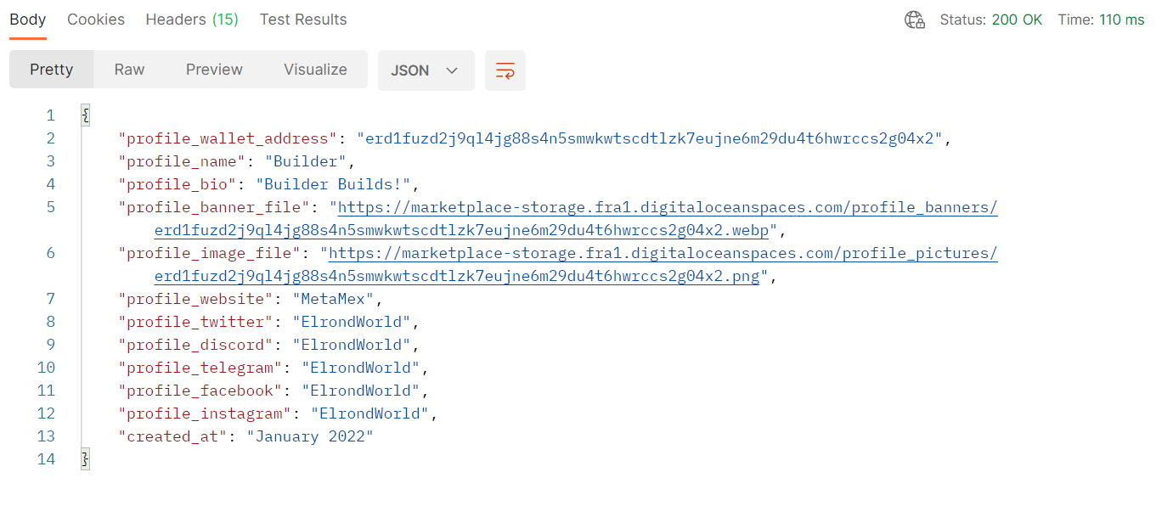
Backend
Golang
DDD
User data
Cloud space
Database
API
Backend - Profile data response
13

Slide 14
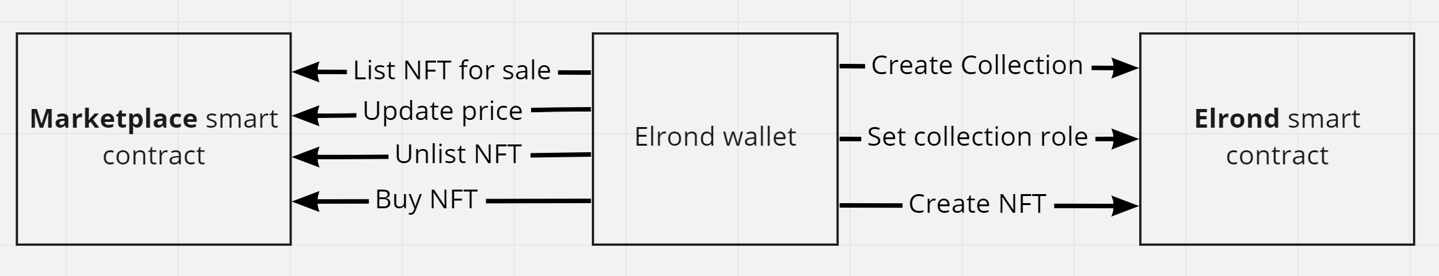
Smart contract
WASM
Rust
Methods
View-s (listings, details)
Multi - smart contract architecture
14

Slide 15
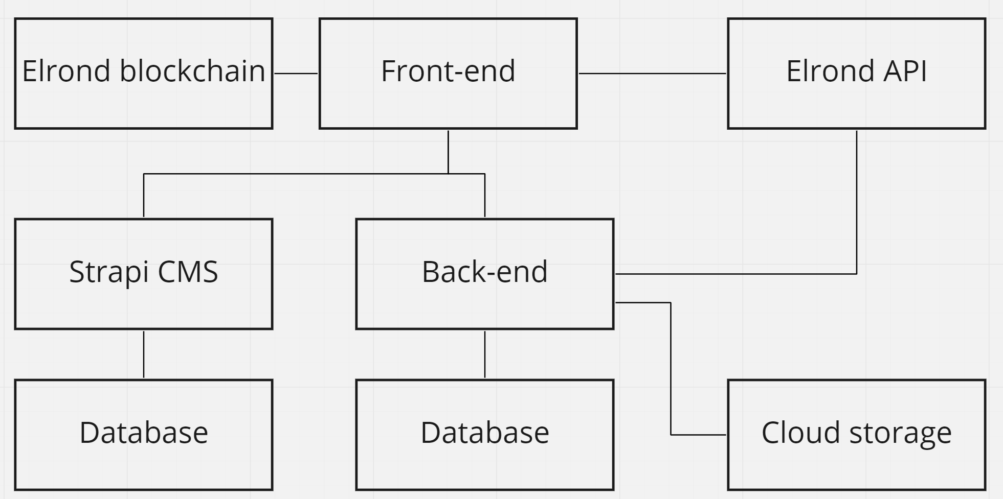
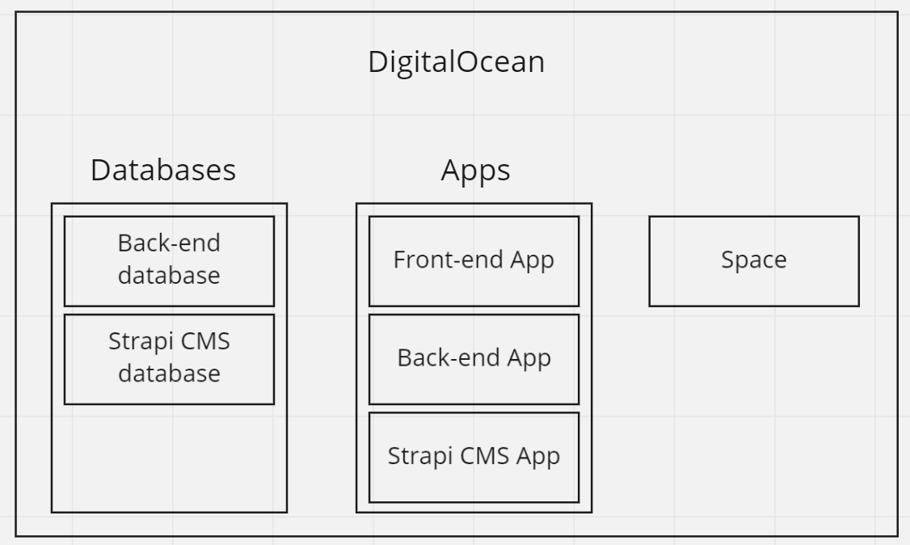
infrastructure
Hybrid Application
Components
Digital Ocean
Apps
Docker
Space
Database
Hybrid application architecture
DigitalOcean components
15

Slide 16
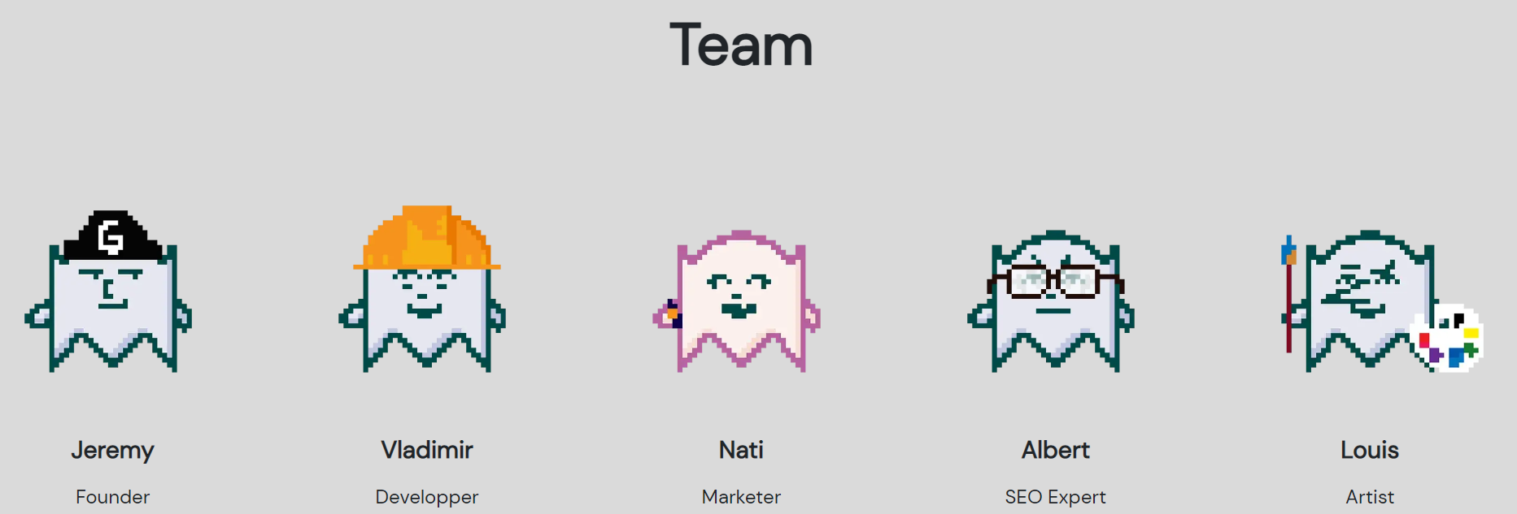
Gokai labs Team
16

Slide 17
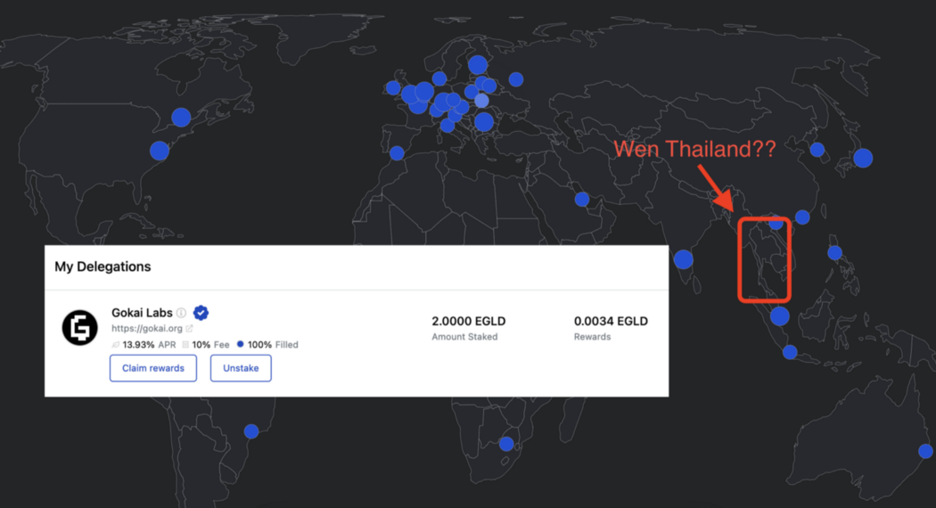
DAO - Decentralized autonomous organization
Distributed
Europe
Estonia
Romania
Asia
Thailand
Gokai Labs Asia launch
17

Slide 18
Results
18

Slide 19
Results
MetaMex
Community platform
Marketing package
Beginner artists support
Elrond - Innovative EU blockchain project
Infrastructure
Monthly infrastructure costs: 35$
DAO
Distributed team
19

Slide 20


TALLINN UNIVERSITY OF TECHNOLOGY
taltech.ee/en
20

